Slide 1


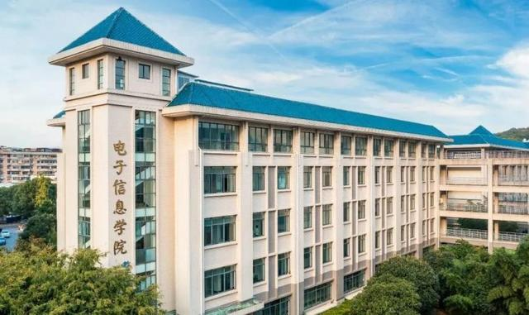
学术前沿讲座
Flexible Multimodal Biometrics for Robust Identity Recognition
Andrew Beng Jin Teoh, 韩国延世大学工程学院
Abstract: Modern biometric research is moving beyond single-trait systems toward agile platforms that can learn, align, and protect multiple human modalities on demand. This talk highlights the emerging paradigm of flexible multimodal biometrics. These systems can seamlessly switch between, fuse, or cross-match traits such as face and periocular regions, depending on what is available at enrolment or inference. We begin by motivating the need for flexibility: occlusions, domain shifts, privacy regulations, and the push toward edge deployment all limit the reliability of classic face-only pipelines. Next, we outline recent deep-learning strategies that enable adaptability: shared-parameter encoders that encourage modality-invariant embeddings; knowledge-distillation and attention-alignment schemes that transfer discriminative cues from rich modalities to sparse ones; and contrastive or prompt-tuning losses that explicitly bridge modality gaps while preserving intra-trait accuracy. Finally, we will then highlight security-aware extensions, cancellable hashing, and adversarial template protection that safeguard modality-invariant representations without sacrificing recognition performance.
时间：2025年7月9日，下午14:30-16:30
地点：武汉大学信息学部3区2-101教室
主办单位：武汉大学电子信息学院
邀请人：余淮 特聘副研究员

